Slide 1


Exploring the Factors Positively Influence the Adoption of Cloud Computing in
Sri Lanka
B.Sc. Special Honours Degree In Information Technology
Field Specialization : Information Systems
Final Presentation

Slide 2
Research ID - IS-12 005
Researcher
A.G.L.N.Silva - IT 09 2053 76

Slide 3
Presentation Outline
INTRODUCTION
Background of the Research
Literature Review
Research Problem
RESEARCH OBJECTIVES
The Research Questions
Main Objective
Sub Objectives
RESEARCH METHODOLOGY
CASE STUDIES ANALYSIS
- Company A
- Company B
- Company C
- Company D

Slide 4
Presentation Outline cont..
DISCUSSIONS AND FINDINGS
LIMITATIONS
CONCLUSION

Slide 5

Introduction
Background of the research
Focus area of the research
How cloud computing derived?
What is cloud computing?
A.G.L.N.Silva
IT 09 2053 76

Slide 6
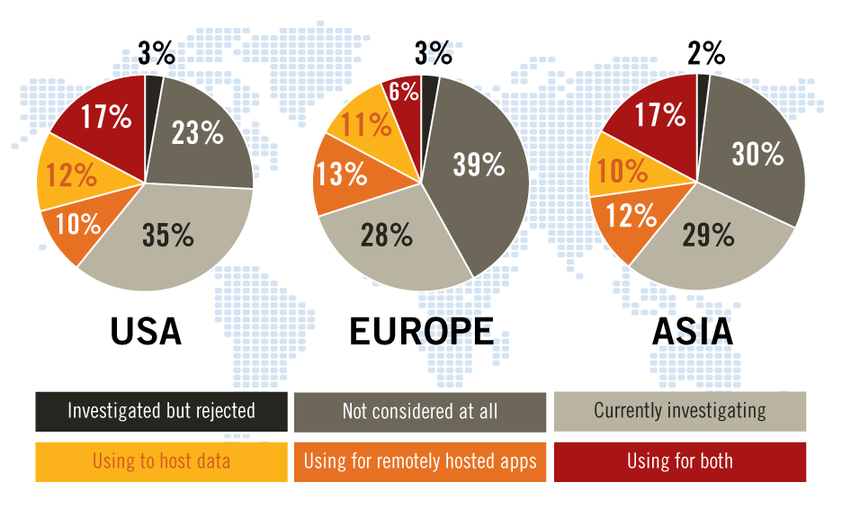

Literature Review
Figure:1 Organization's Position In Relation To Cloud Computing, By Region
Source: Adoption, Approaches & Attitudes -The Future of Cloud Computing in the Public and Private Sectors : A Global Cloud Computing Study June 2011
A.G.L.N.Silva
IT 09 2053 76

Slide 7

Literature Review cont..
Figure 2: the single biggest inhibitor to the adoption of cloud
(For those considering implementation)

Slide 8
Literature Review cont..
A few models available to evaluate adoptability of cloud computing
Most of the models are developed by vendors
Most of the models are evaluated in developed countries
In Sri Lankan context no proper model for cloud adoption from organizational perspective

Slide 9

Research Problem
The organizations in developing countries like Sri Lanka are lacking in responding to the adoption of cloud computing.
The reason for this problem is that the Sri Lankan organizations are not aware of the influencing factors to the adoption of cloud computing.
A.G.L.N.Silva
IT 09 2053 76

Slide 10
Objective of the Research
The Research Questions
What are the influencing factors to the adoption of cloud computing in Sri Lanka?
How these factors positively influence the adoption of cloud computing in Sri Lankan organizations?
Main Objective
To discover the factors positively influencing to the adoption of cloud computing.
The influencing factors to the adoption of Cloud Computing identified in three perspective.
Technological Factors
Organizational Factors
Environmental Factors.
A.G.L.N.Silva
IT 09 2053 76

Slide 11
Sub Objectives
Sub Objective 1
To identify what are the Technological Factors influence the cloud adoption in Sri Lanka.
To understand how these factors do positively influence the adoption of cloud computing in Sri Lankan organizations.
Sub Objective 2
To identify what are the Organizational Factors influence the cloud adoption in Sri Lanka.
To identify how these factors do positively influence the adoption of cloud computing in Sri Lankan organizations.
Sub Objective 3
To understand what are the Environmental Factors influence the cloud adoption in Sri Lanka.
To identify how these factors do positively influence the adoption of cloud computing in Sri Lankan organizations.
Sub Objective 4
To develop a Factor Framework for the positively influencing factors to the adoption of cloud computing in Sri Lanka.

Slide 12


Research Methodology
A.G.L.N.Silva
IT 09 2053 76

Slide 13
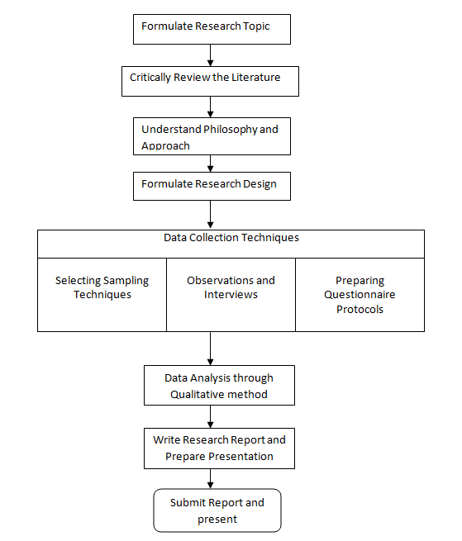
Research Methodology
A.G.L.N.Silva
IT 09 2053 76
Figure 3: Research Process

Slide 14
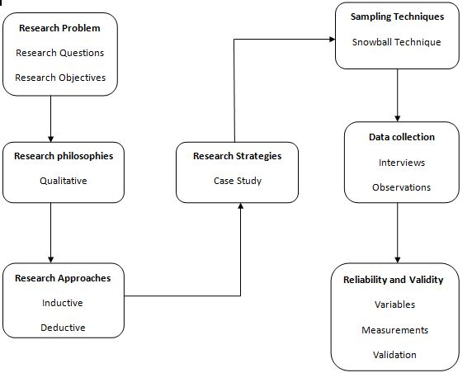

Methodology cont..
Figure 4: Research Design
A.G.L.N.Silva
IT 09 2053 76

Slide 15
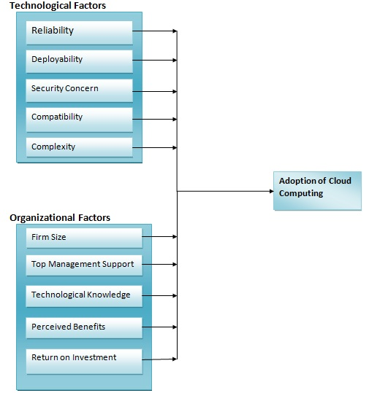
Research Methodology cont..
A.G.L.N.Silva
IT 09 2053 76
Figure 5: Conceptual model

Slide 16

Case Study Analysis
A.G.L.N.Silva
IT 09 2053 76

Slide 17
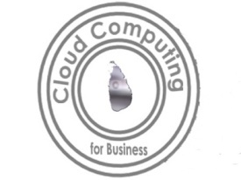
Case Study Analysis
Company A
Background - Company A is a leading Human Capital Management software solutions provider. It designed the Sri Lanka’s first ever web based HRIS solution introducing the employee self-service concept to clients like telecoms, banks and financial services and other key corporate customers. Also the company became an industry recognized mobile & media technology provider.
Discussion with – Respective Director of company A
Legacy System – In house built software solutions
Reasons for cloud adoption
Cost reduction
Flexibility
Less resources usage
Easy to collaborate and administrate
Cloud usage – Human Capital Management, Customer Relationship Management and Collaboration
A.G.L.N.Silva
IT 09 2053 76

Slide 18
Case Study Analysis cont..
Company B
Background - Company B operates in graphite mining, processing and exporting industry in Sri Lanka which has two branches in Colombo and Bogala. The company mainly deal with a German company.
Discussion with – Respective CIO of company B
Legacy System – In house built software products and outsourced solutions
Reasons for cloud adoption
Physical location of branches
Lack of technological knowledge
Mobility
Reduce IT issues
Cloud usage – Human Resources Management Systems and Mining Related Systems
A.G.L.N.Silva
IT 09 2053 76

Slide 19
Case Study Analysis cont..
Company C
Background - Company C is a customer focused local software company which develops software brands for international market. It is providing many services such as “Travel Box”, “Revel Box Technology”, “Zoom”, “Savaree” and “Check” into Sri Lanka.
Discussion with – Head of system networking of company C
Legacy System – Some other web technologies
Reasons for cloud adoption
Physical location
To provide solutions to clients
Easy to access
Cloud usage – Test software products and Deliver software products
A.G.L.N.Silva
IT 09 2053 76

Slide 20
Case Studies Analysis cont..
Company D
Background - Company D is a subsidiary of Singapore Telecom, which is a Joint-venture between Singapore Telecom International and Capital Development and Investment Company. It is the pioneer in providing Data Communication and Internet Services in Sri Lanka.
Discussion with – Head of network planning department of company D
Legacy System – In house built software solutions
Reasons for cloud adoption
Business requirement
Cater to a large customer base
Physical location
Cloud usage – Provide software solutions and Collaboration
A.G.L.N.Silva
IT 09 2053 76

Slide 21

Discussions and Findings
A.G.L.N.Silva
IT 09 2053 76

Slide 22
Discussion
Perception of industrial professionals are taken into account in the discussion.
Each factor identified from the literature are discussed in the industrial professionals point of view.
Only the positively influencing factors are selected to develop the conceptual model as an outcome of this research.
A.G.L.N.Silva
IT 09 2053 76

Slide 23
Discussion on Organizational Factors
Return on investment: is not included in the model
Firm Size
Top Management support
Company A
Company B
Company C
Company D
Positively influencing the adoption of cloud computing
Technological Knowledge
Perceived Benefits
Figure 6: Organizational Factors that positively influences the adoption of cloud computing

Slide 24
Discussion on Technological Factors
Reliability
Deployability
Company A
Company B
Company C
Company D
Positively influencing the adoption of cloud computing
Security concern
Compatibility
Simplicity
Figure 7: Technological Factors that positively influences the adoption of cloud computing
A.G.L.N.Silva
IT 09 2053 76

Slide 25
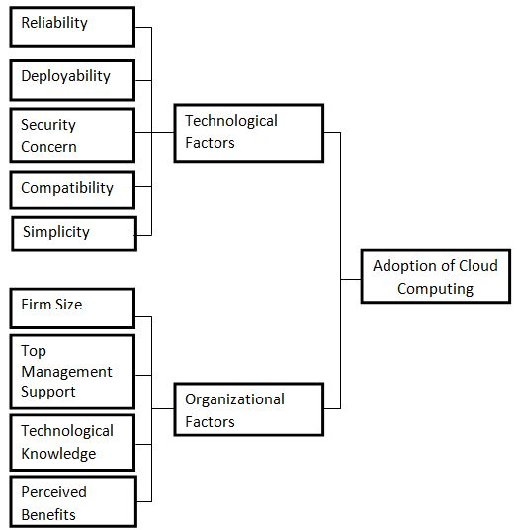
Outcome of the research
Figure 8: Conceptual model

Slide 26
Future work
Professionals from companies A, B, and D suggested factor to be added in the conceptual model
User experience as a technological factor
Socialization as a technological factor
Work efficiency as a technological factor
These factors can be validated and added to the conceptual model as a future progress.
A.G.L.N.Silva
IT 09 2053 76

Slide 27
Future work cont……
Environmental factors identified from the literature review
Supplier marketing activity
Targeting
Risk Reduction
Environmental influences
Environmental Factors considered for adoption and suggested by the industrial professionals
Carbon free environment
Reduce power consumption
Less heat production
Greener environment

Slide 28
Limitations
Time limitation
Limited geographical area
cloud adopted companies are less
Communicating via email and social networks will not be considered as cloud computing infrastructure. The organizations which use cloud computing to their core business functions.
There is a lack of cloud adopted companies is Sri Lanka still therefore finding cloud adopted companies and the resistance to give the information for a third party.
A.G.L.N.Silva
IT 09 2053 76

Slide 29
Conclusion
Factors identified from the literature review are validated and added in to the conceptual model.
Suggestions are stated for the further continuation of the research
Development of the conceptual model which could guide Sri Lankan organization towards successful adoption of cloud computing.
A.G.L.N.Silva
IT 09 2053 76

Slide 30

Thank You

